Slide 1
UNIT-6

Slide 2
TURING MACHINE
What is a Turing Machine?
A Turing Machine as a machine with a finite number of control states and an infinite tape.
The tape is divided into cells, each of which can hold one symbol. The input of the machine is a string w = w1 w2 . . . wn initially written on the leftmost portion of the tape, followed by an infinite sequence of blanks B.

Slide 3
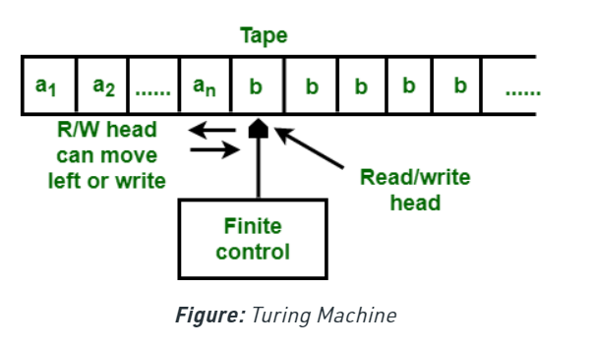
TURING MACHINE

Slide 4
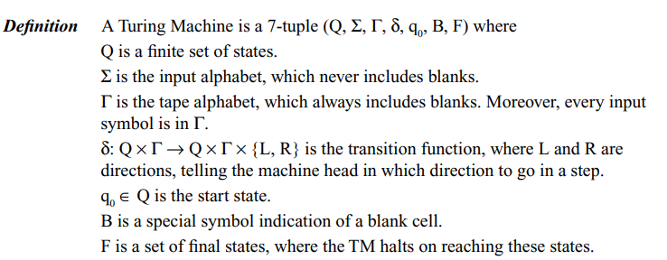
TURING MACHINE

Slide 5
TURING MACHINE
δ(q_{i} , a) = (q_{j} , b, L or R) is made by a TM M:
TM writes b to the current tape cell, overwriting a.
The current state changes from q_{i} to q_{j} .
The tape head moves to the left or right by one cell (L or R)

Slide 6
INSTANTANEOUS DESCRIPTION OF TM

Slide 7
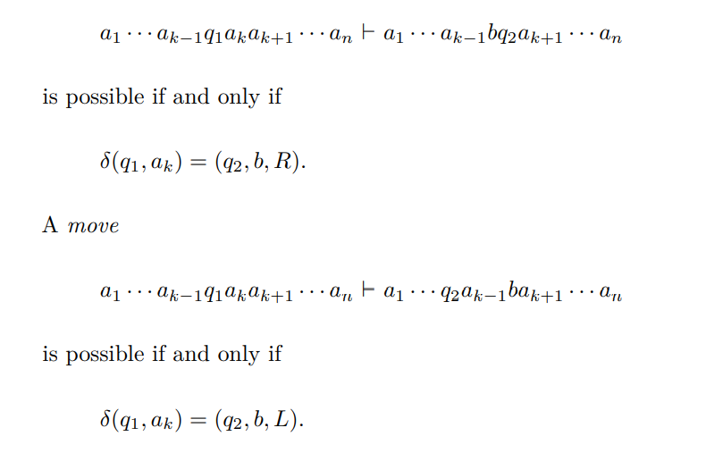
INSTANTANEOUS DESCRIPTION OF TM

Slide 8
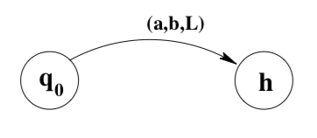
INSTANTANEOUS DESCRIPTION OF TM
indicates that when the machine is in state q0 and reads an a, it writes b, moves left, and enters state h.

Slide 9
THE LANGUAGE OF A TURING MACHINE

Slide 10
TURING MACHINE PROBLEMS
Design a TM to accept strings belonging to the language (0 + 1)*.

Slide 11
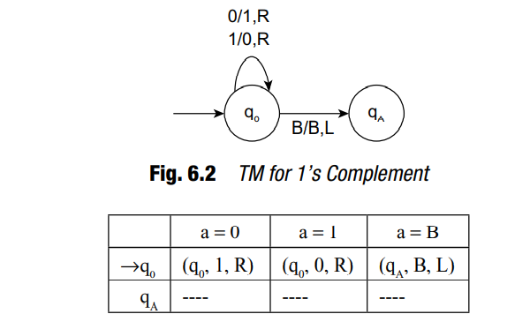
TURING MACHINE PROBLEMS

Slide 12
MULTI TAPE TURING MACHINE
A Turing machine (TM) with several tapes is called a multi tape Turing machine.
Every tape’s have their own Read/Write head
For N-tape Turing Machine
M={( Q,X, ∑,δ,q0,B,F)}
We define Multi-tape Turing machine as k-tapes with k-tape heads moving independently (generalisation of multi-track Turing machines).
δ=QxX^{N} ->Q x X^{N} x {L,R}^{N}

Slide 13
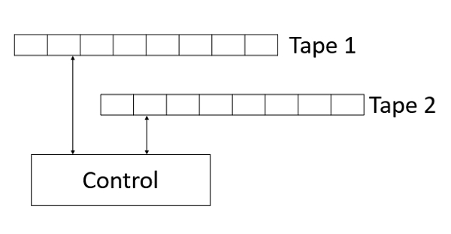
MULTI TAPE TURING MACHINE

Slide 14
MULTI TAPE TURING MACHINE
A Multi-tape Turing machine can be formally described as a 6-tuple (Q, X, B, δ, q₀, F) where −
Q is a finite set of states
X is the tape alphabet
B is the blank symbol
δ is a relation on states and symbols where
δ: Q × X^{k} → Q × (X × {Left_shift, Right_shift, No_shift })^{k}
where there is k number of tapes
q₀ is the initial state
F is the set of final state

Slide 15
RESTRICTED TURING MACHINES
1. Halting Turing Machine :
A Turing Machine is said to be a halting Turing machine if it always halts for every input string. It can accept the recursive language and is less powerful than Turing machine.
2. Linear Bounded Automata :
It behaves as a Turing machine but the storage space of tape is restricted only to the length of the input string. It is less powerful than a Turing machine but more powerful than push down automata.

Slide 16
RESTRICTED TURING MACHINE
3. Unidirectional Turing Machine :
The head of this type of turing machine can move only in one direction. It can accept the only regular language. It has the same power as finite automata but less powerful than push down automata.
4. Read Only Turing Machine :
It is equivalent to finite automata. It contains a read head only which doesn’t have written capability. It accepts only regular languages.
5. Read Only-Unidirectional Turing Machine :
It is similar to finite automata. It contains a read-only head and can move only in one direction. It accepts a regular language.

Slide 17
Multi-Stack Turing Machine
A deterministic two-stack machine is a deterministic TM with a read only input and two storage tapes. If a head moves left on either tape, a blank is printed on that tape.
The symbols to the left of the head of the TM being simulated can be stored on the stack, while the symbols on the right of the head can be placed on the other stack.

Slide 18
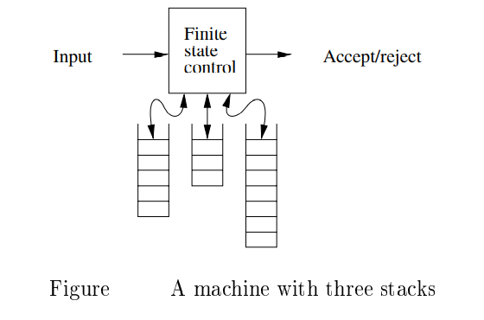
Multi-Stack Turing Machine

Slide 19
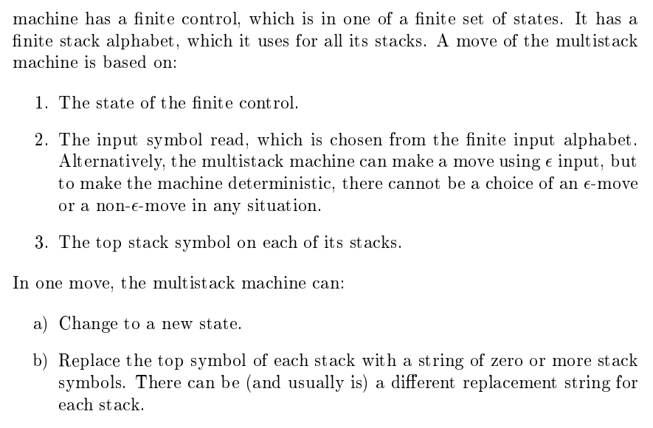
Multi-Stack Turing Machine

Slide 20
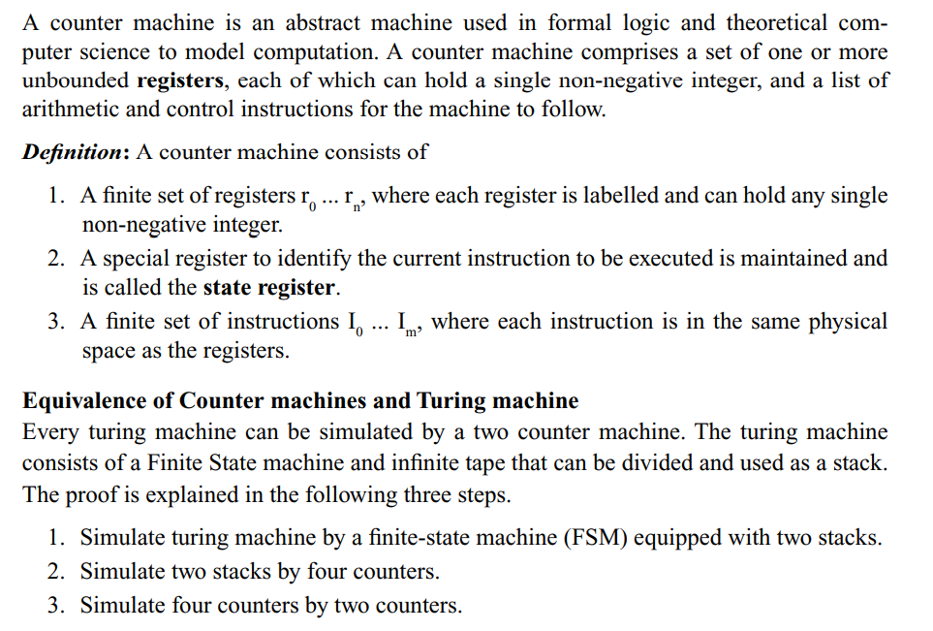
COUNTER MACHINE

Slide 21
Universal Turing Machine
Universal Turing Machine can be considered as a subset of all the Turing machines, it can match or surpass other Turing machines including itself.
Universal Turing Machine is like a single Turing Machine that has a solution to all problems that is computable.
It contains a Turning Machine description as input along with an input string, runs the Turning Machine on the input and returns a result.

Slide 22
Church’s Thesis
A problem can be solved by an algorithm iff it can be solved by a Turing machine
All algorithmically solvable problems can be solved by a Turing Machine
The Church–Turing thesis (formerly commonly known simply as Church’s thesis) says that any real-world computation can be translated into an equivalent computation involving a TM
The Church–Turing thesis can be applied to any kind of computations, those involving cellular automata, combinators, register machines and substitution systems. It is also applicable to other kinds of computations found in theoretical computer science, such as quantum computing and probabilistic computing.

Slide 24
Recursive Language and Recursive Enumerable Language
There are three possible outcomes of executing a TM over a given input.
The TM may
halt and accept the input;
halt and reject the input; or
never halt.

Slide 25
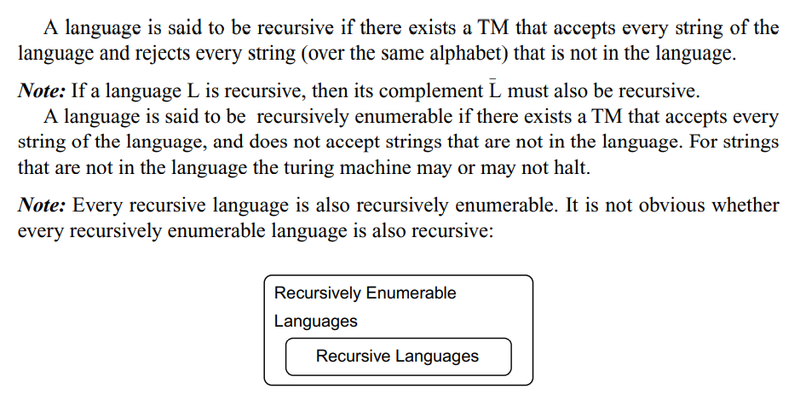
Recursive Language and Recursive Enumerable Language

